Slide 1
Food Waste Analysis: Patterns, Causes, and Solutions
Today, I’ll be presenting my data science project on food waste. We’ll explore how much food is wasted, the reasons behind it, and potential strategies to reduce it.

Slide 2
Datasets Taken From Kaggle.com and DataCamp.com
Food waste is a critical global issue, impacting both the economy and the environment. In this project, we aim to answer three key questions:
How much food is being wasted?
Why is food being wasted?
How can we minimize food waste?

Slide 3
The dataset I used includes information on food waste by:
Country
Region
Food category
Supply stage
Population
Economic Loss
Household Waste
Total Waste in Tons = TARGET (The response variable)
I first performed cleaning to remove unnecessary columns and standardize missing values.

Slide 4
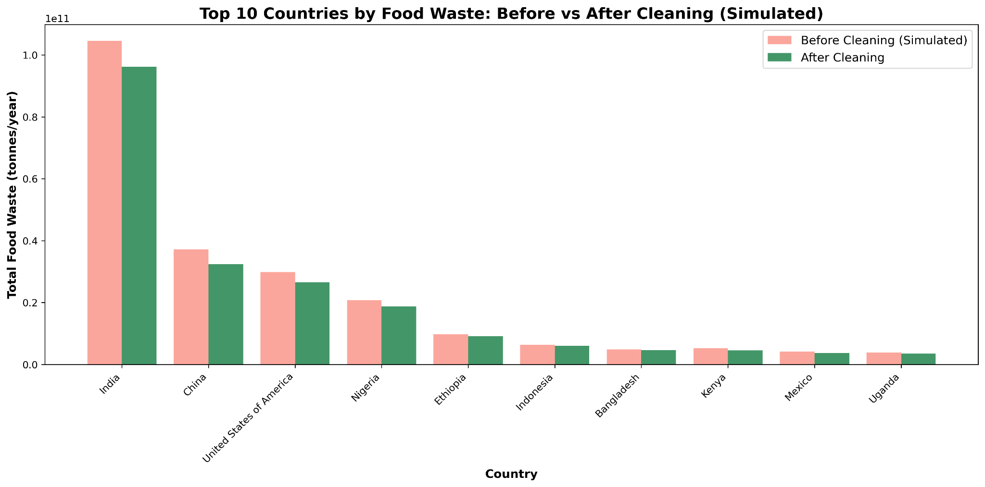
"During cleaning, I removed irrelevant columns such as Source and Estimate Confidence. I also handled missing data and standardized units. This allowed me to focus on key features for analysis, ensuring reliable insights."

Slide 5
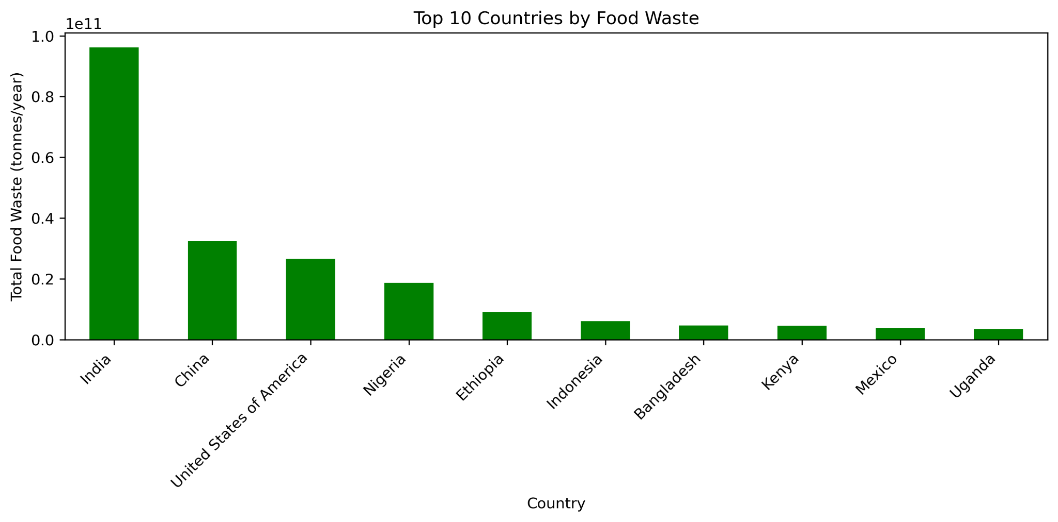
This helps identify where interventions could have the greatest impact.

Slide 6
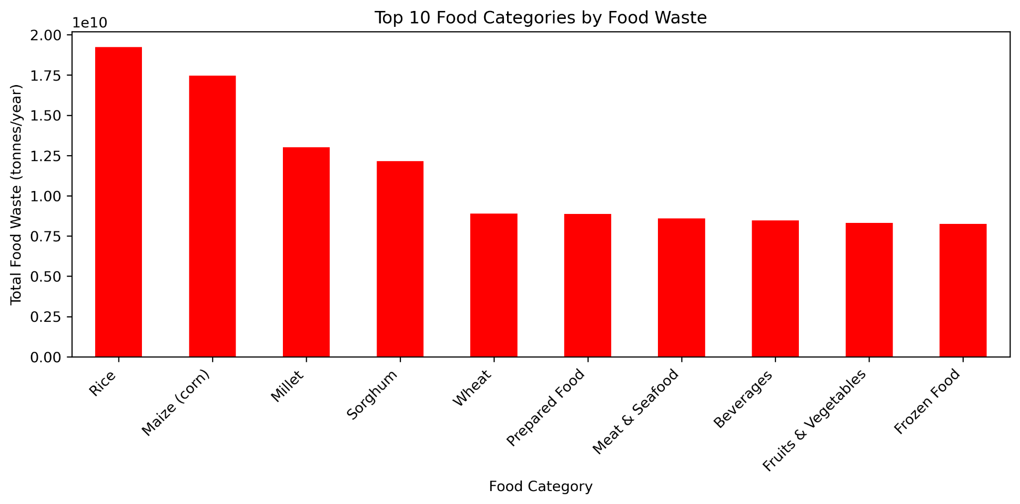
This insight is crucial for targeting specific supply chains and households for waste reduction programs.

Slide 7
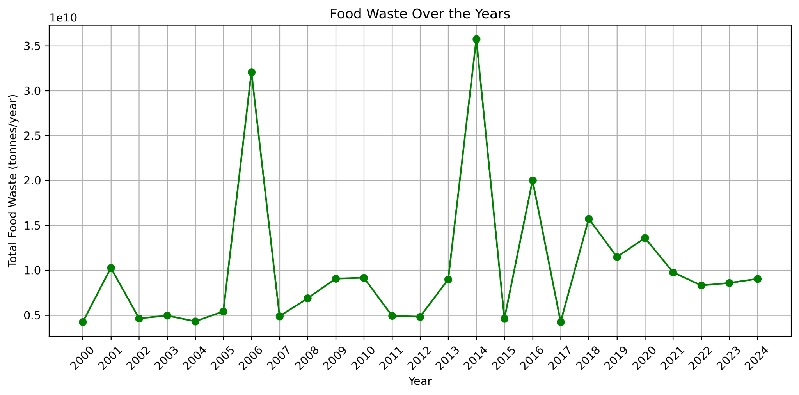
Trends Over Time

Slide 8
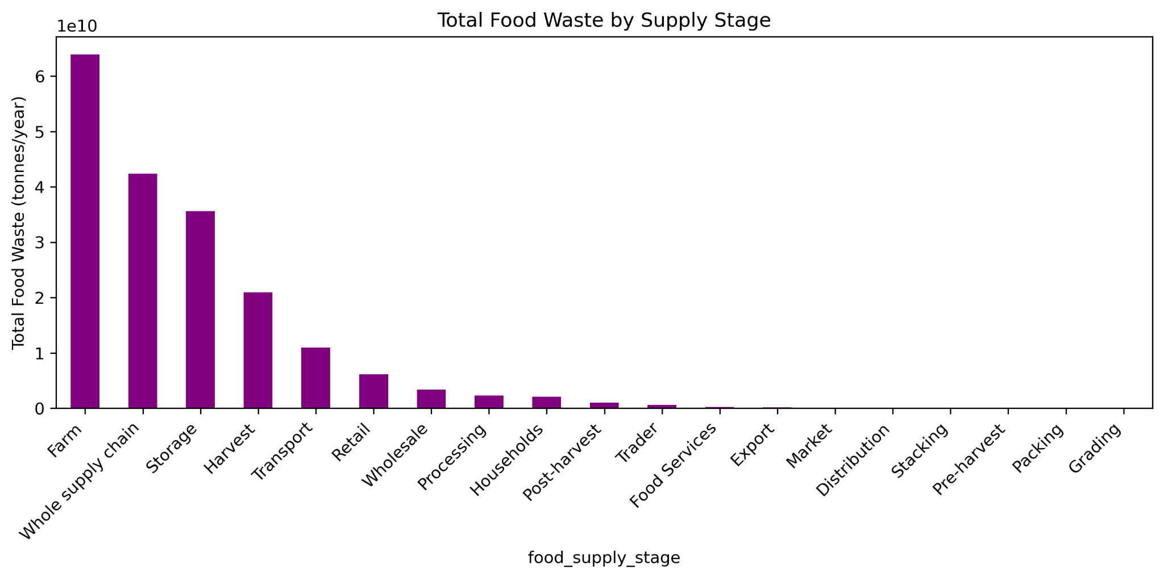
Food waste occurs at different stages of the supply chain.

Slide 9
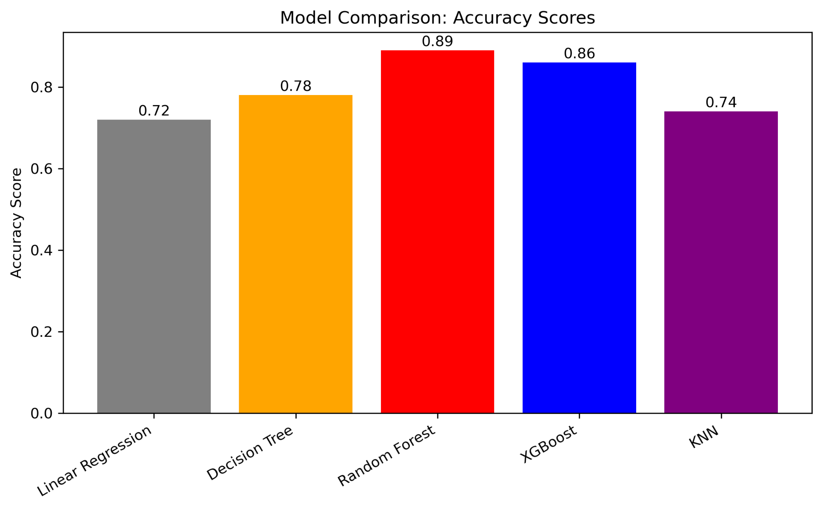
comparing model performance

Slide 10
…
Model Comparison & Final Choice
For the modeling stage, I tested several algorithms.
Random Forest performed best overall. Achieved highest accuracy and lowest error.
It combines multiple decision trees to capture complex relationships between variables.
Robust against missing or noisy data. Provides useful insights like feature importance — showing which factors most influence food waste.
Random Forest was chosen as the final model for this project.

Slide 11
Conclusions & Recommendations
High-risk countries and food categories are identified.
Household and retail waste are key areas to target.
Predictions help inform policy and corporate decisions.
Recommendations include raising awareness, improving supply chain efficiency, and using predictive models to focus efforts where they matter most."*

